Slide 1


EPFLU: Efficient Peer-to-peer Federated Learning for Personalized User Models in Edge-Cloud Environments
BECS 2024
Tampere, Finland 17-20 June 2024
Presenter: Xiangchi Song
Xiangchi Song*, Zhaoyan Wang, Kyeongdeok Baek, and In-Young Ko
{xcsong, zhaoyan123, kyeongdeok.baek, iko}@kaist.ac.kr
Web Engineering and Service Computing Lab, Korea Advanced Institute of Science and Technology (KAIST)
2024. 06. 17

Slide 2
Introduction
Notes:
Let’s begin with the introduction.

Slide 3
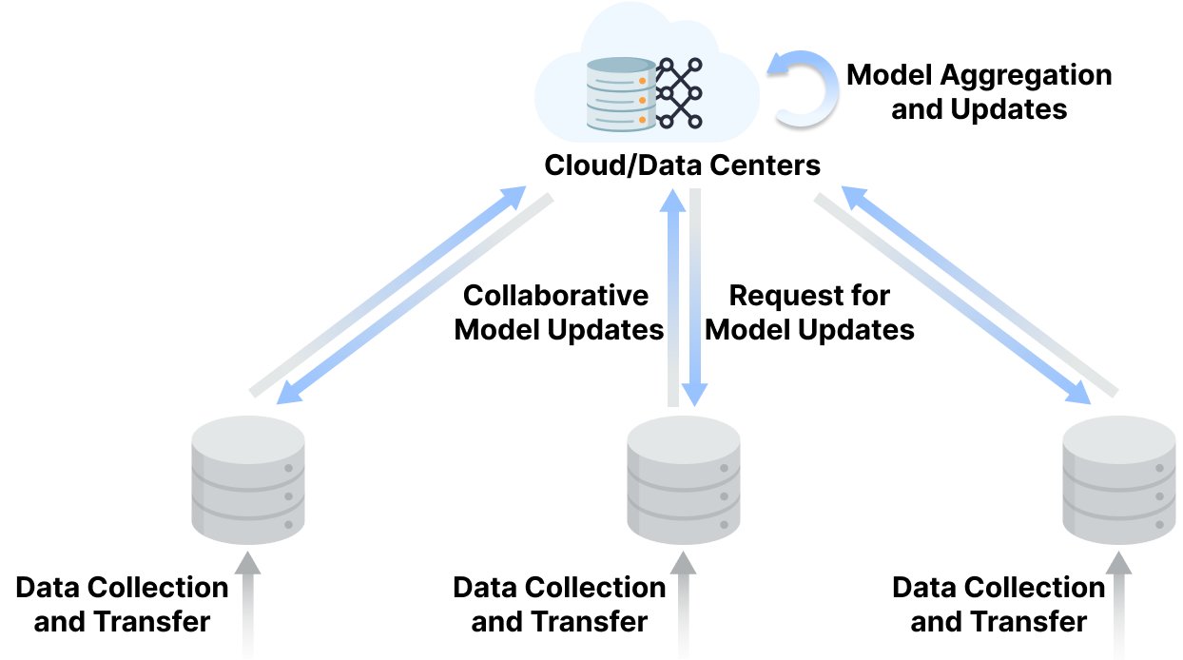
Federated Learning
Introduction
Federated Leaning ^{[1]}
The process of using the cloud center to conduct collaborative training of distributed data
[1] McMahan, B., Moore, E., Ramage, D., Hampson, S., y Arcas, B.A.: Communication-efficient learning of deep networks from decentralized data. In: Artificial intelligence and statistics. pp. 1273–1282. PMLR (2017)

Slide 4
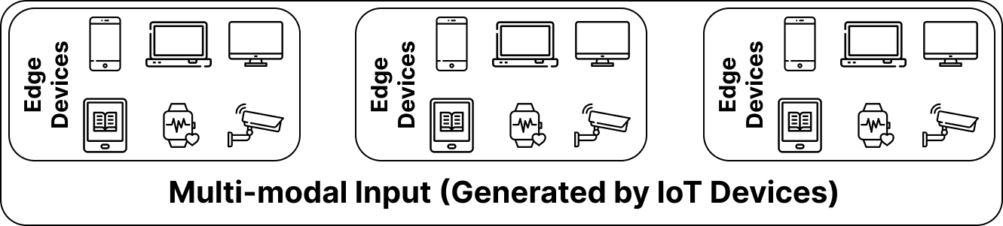
Generated Data Collaborative Training
Introduction
Distributed system based on Federated Learning ^{[1]}
Suitable for centralized training of large amounts of distributed data
Protecting privacy through only parameter sharing.
Global model will use all user data.
[1] McMahan, B., Moore, E., Ramage, D., Hampson, S., y Arcas, B.A.: Communication-efficient learning of deep networks from decentralized data. In: Artificial intelligence and statistics. pp. 1273–1282. PMLR (2017)

Slide 5
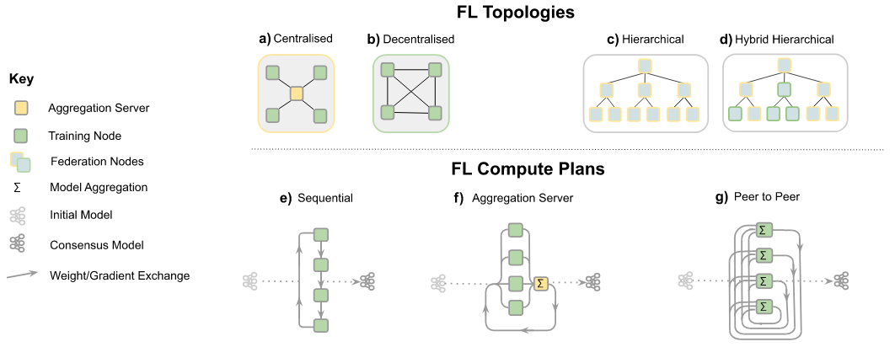
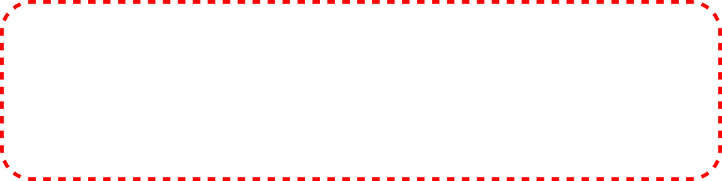
Peer-to-peer Federated Learning
Introduction
P2P Federated Learning^{[4]}
Alternative formula for FL
Each node exchanges models with some or all of its peers
Each node performs its own aggregation, no need to share globally
[4] Rieke N, Hancox J, Li W, et al. The future of digital health with federated learning[J]. NPJ digital medicine, 2020, 3(1): 1-7.

Slide 6
Problems in Traditional FL
Problem Scenario
Traditional FL
High communication overhead
Common used global model
……

Slide 7
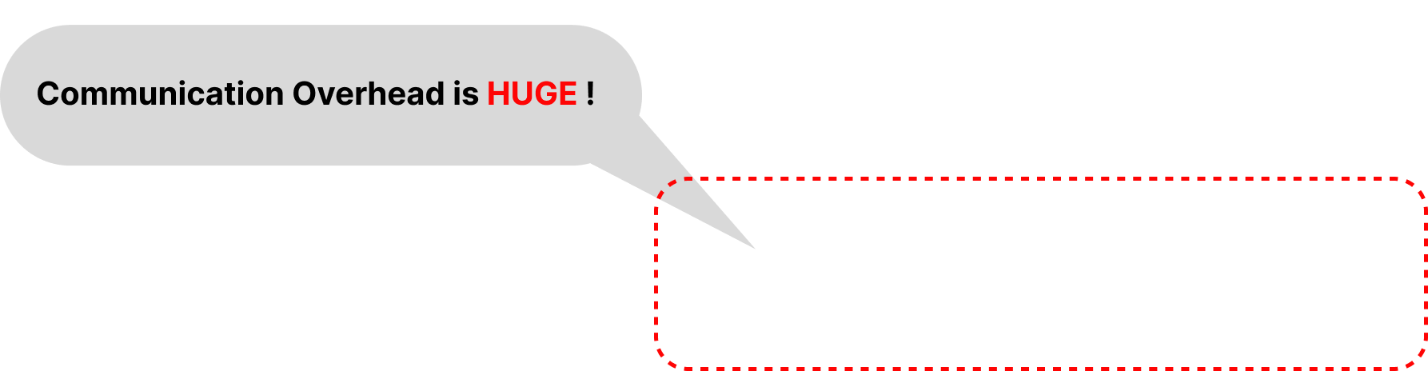

Challenge 1 - Communication Overhead
Problem Scenario
Communication Overhead
Central server is a bottleneck in distributed parallel systems with a large number of clients ^{[3]}.
The quality of vertical links often becomes the primary source of consumption.
P2P-FL is a good choice
[3] Lian, X., Zhang, C., Zhang, H., Hsieh, C.J., Zhang, W., Liu, J.: Can decentralized algorithms outperform centralized algorithms? a case study for decentralized parallel stochastic gradient descent. Advances in neural information processing systems 30 (2017)

Slide 8
Challenge 2 - Data Heterogeneity
Problem Scenario
Data Heterogeneity
Heterogeneity of IoT devices in modern Edge-Cloud Env.
Nothing is known about the type, amount and distribution of data on the user’s client.
Personalization

Slide 9
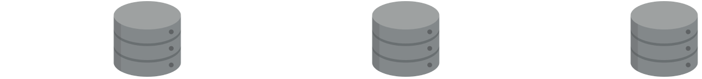
Challenge 3 - Weakening Effect
Problem Scenario
Weakening Effect
Not all IoT devices necessarily benefit from the global model of traditional FL due to Heterogeneity Problems [5].
A federated learning solution that can reduce communication delay and cost, relieve cloud-edge communication pressure, and can be customized for different users.
Personalization
[5] Dang Q, Zhang G, Wang L, et al. Hybrid IoT Device Selection With Knowledge Transfer for Federated Learning[J]. IEEE Internet of Things Journal, 2023.

Slide 10
Related Works
Notes:
Now I will present some related works to this problem.

Slide 11
Related Works & Baselines
Related Work
Method | Venue/Year | Collaboration Scheme | Personalization | Description
FedAvg^{[1]} | PMLR/2017 | Vertical-FL | ❌ | [Baseline] Random sampling, global aggregation
FedAdam^{[8][11]} | TPDS/2021 | Vertical-Adaptive Federated Optimization | Private parameter personalization | [SOTA] Random sampling, consensus global aggregation
CE-FedAvg^{[6]} | IoT Journal/2019 | Vertical-FL | ❌ | Reduce vertical communication cost by compressing the model
PPT^{[7]} | Computers & Security/2023 | Horizontal-P2PFL | ❌ | [Baseline] Cumulative aggregation of temporary models
Consensus: Common information about models and data
Temporary: Intermediate model during aggregation
[6] Mills J, Hu J, Min G. Communication-efficient federated learning for wireless edge intelligence in IoT[J]. IEEE Internet of Things Journal, 2019, 7(7): 5986-5994.
[7] Chen Q, Wang Z, Zhang W, et al. PPT: A privacy-preserving global model training protocol for federated learning in P2P networks[J]. Computers & Security, 2023, 124: 102966.
[8] Mills, J., Hu, J., Min, G.: Multi-task federated learning for personalised deep neural networks in edge computing. IEEE Transactions on Parallel and Distributed Systems 33(3), 630–641 (2021).
[11] Reddi, S., Charles, Z., Zaheer, M., Garrett, Z., Rush, K., Koneˇcn ́y, J., Kumar, S., McMahan, H.: Adaptive federated optimization. arXiv: Learning,arXiv: Learning (Feb 2020)

Slide 12
Approach
Notes:
Now I will introduce our approach for autoscaling in fog-computing systems.

Slide 13
System Design
Approach
Our method: EPFLU [Efficient Peer-to-peer Federated Learning for Users]

Slide 14
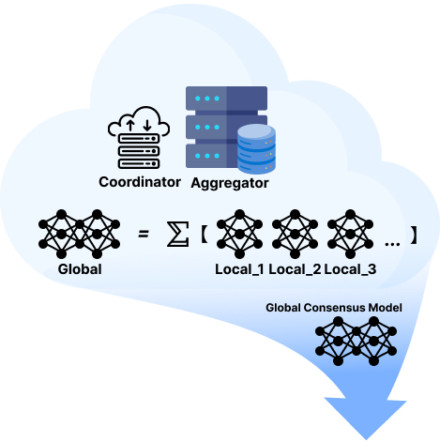
System Design
Approach
Our method: EPFLU [Efficient Peer-to-peer Federated Learning for Users]
EPFLU: A P2PFL approach that considers performance enhancement from the user perspective
Transition traditional vertical FL to horizontal P2P structure
Alleviate cloud-edge communication pressure
Reduce communication latency and cost

Slide 15
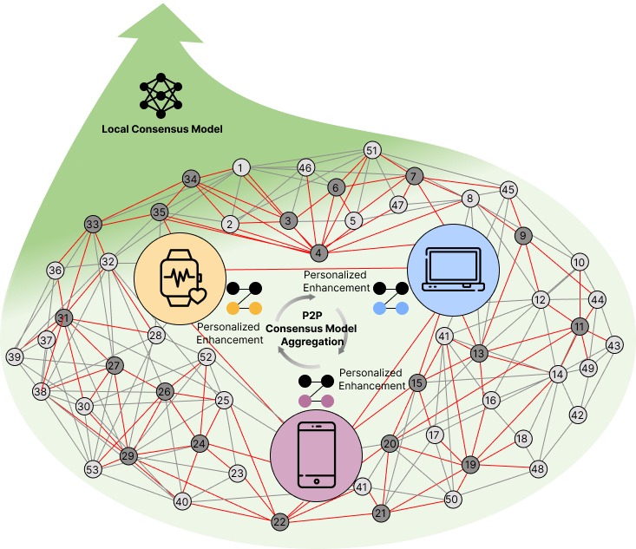
System Design
Approach
Our method: EPFLU [Efficient Peer-to-peer Federated Learning for Users]
EPFLU: A P2PFL approach that considers performance enhancement from the user perspective
Consensus information aggregation and private information supplement
Personalize user models to reduce the impact of global models

Slide 16
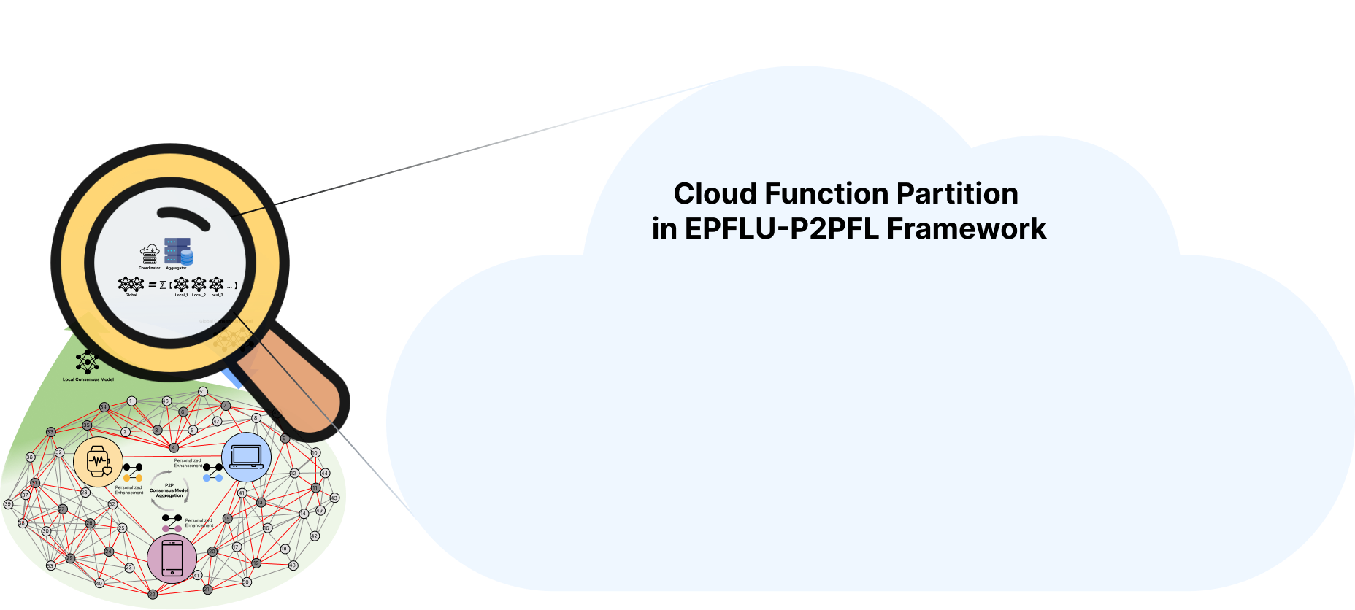
System Design
Approach
EPFLU: A P2PFL approach that considers performance enhancement from the user perspective

Slide 17
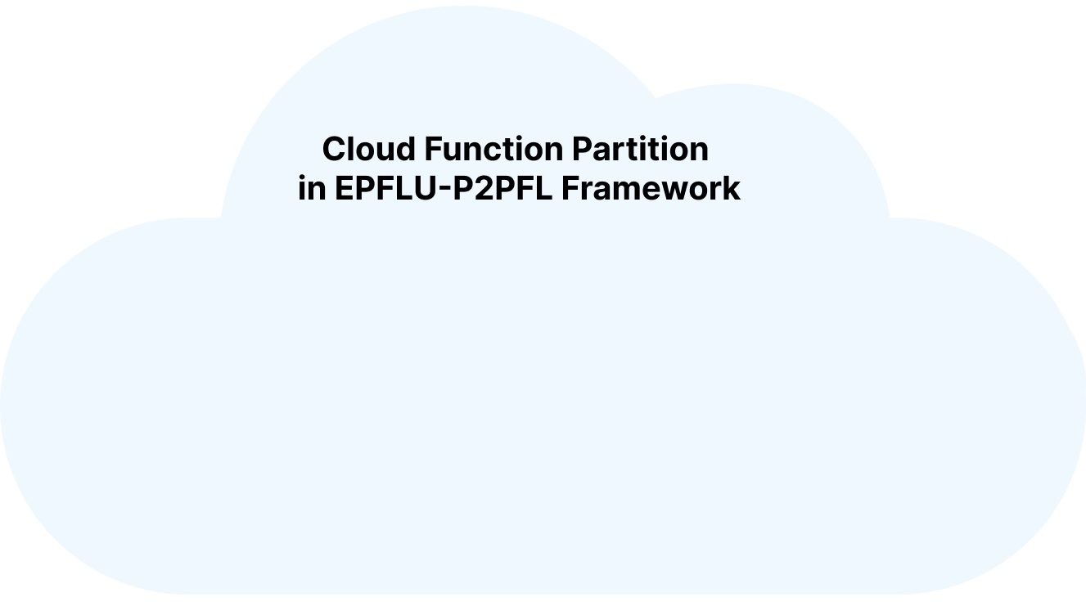
Cloud Function Partition
Approach
Cloud Function Partition in EPFLU-P2PFL Framework

Slide 18
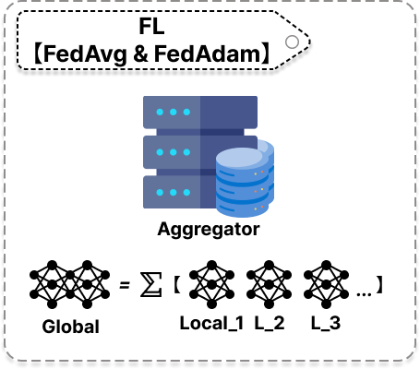
Cloud Function Partition
Approach
Basic FL：Aggregator
Global Aggregation
Global Model Storage

Slide 19
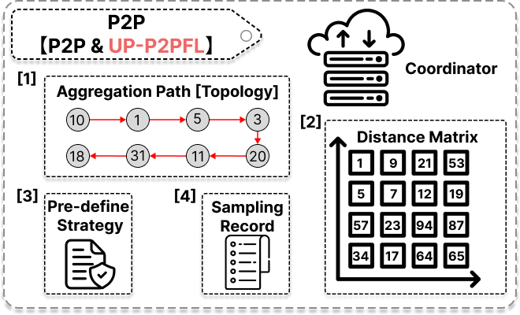
Cloud Function Partition
Approach
EPFLU-P2PFL：Coordinator
Topology Info
Distance Matrix Based on Clients’ distance
Pre-define Strategy for Aggregation
Sampling Record

Slide 20
Cloud Function Partition
Approach
Cloud Function Partition in EPFLU-P2PFL Framework
The coordinator is only responsible for recording and global control，does not have any calculation or aggregation functions.

Slide 21
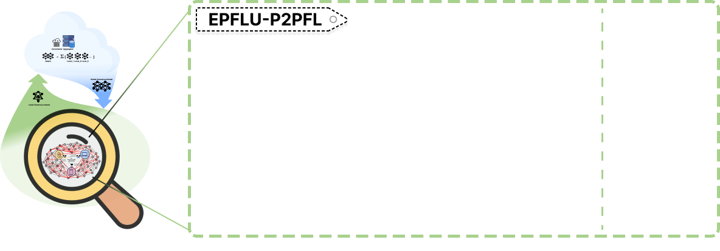
System Design
Approach
EPFLU: A P2PFL approach that considers performance enhancement from the user perspective

Slide 22
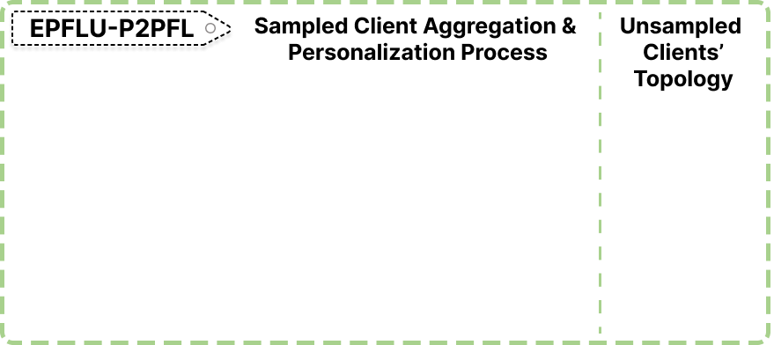
Edge-side P2P Structure
Approach
Sampled Client Aggregation & Personalization Process
The framework is divided into sampled and unsampled parts

Slide 23
Edge-side P2P Structure
Approach
Sampled Client Aggregation & Personalization Process
CM - Consensus Model
TCM - Temporary aggregated Consensus Model
PM - Personalized Model

Slide 24
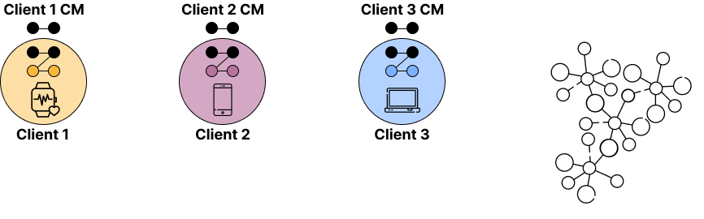
Edge-side P2P Structure
Approach
Sampled Client Aggregation & Personalization Process
The clients use their own private dataset for training.
Private parameters and consensus models for participating clients are ready.
CM - Consensus Model
TCM - Temporary aggregated Consensus Model
PM - Personalized Model

Slide 25
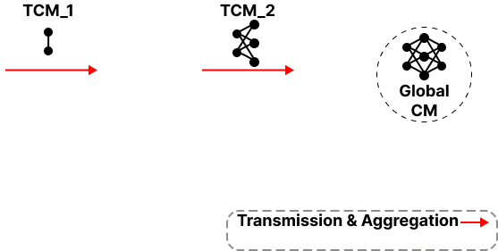
Edge-side P2P Structure
Approach
Sampled Client Aggregation & Personalization Process
Private parameter separation and consensus model aggregation.
The model in the process is TCM, and the final model is Global CM.
CM - Consensus Model
TCM - Temporary aggregated Consensus Model
PM - Personalized Model

Slide 26
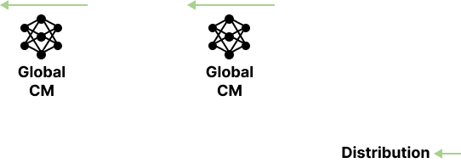
Edge-side P2P Structure
Approach
Sampled Client Aggregation & Personalization Process
Global CM is transmitted back to the participating clients along the topology.
At this point, the global consensus model in the client has been unified.
CM - Consensus Model
TCM - Temporary aggregated Consensus Model
PM - Personalized Model

Slide 27
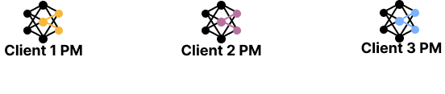
Edge-side P2P Structure
Approach
Sampled Client Aggregation & Personalization Process
Private parameters are integrated and the personalization process is completed.
CM - Consensus Model
TCM - Temporary aggregated Consensus Model
PM - Personalized Model

Slide 28
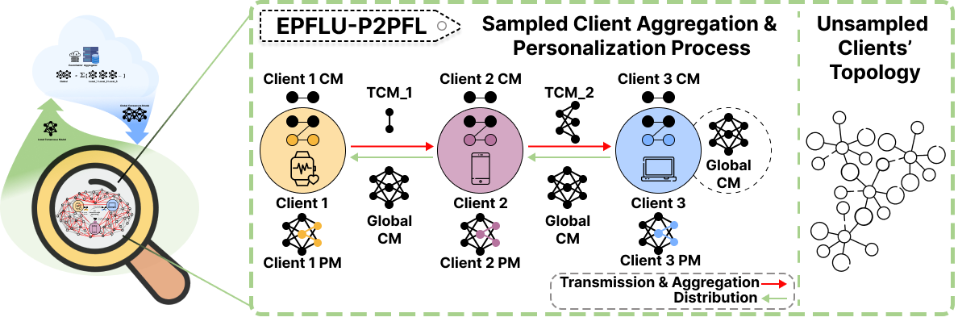
Edge-side P2P Structure
Approach
Sampled Client Aggregation & Personalization Process
A process of P2P cumulative aggregation and return coverage.
The learnable parameters of the device are treated as private information and do not participate in aggregation ^{[8][9]}.
CM - Consensus Model
TCM - Temporary aggregated Consensus Model
PM - Personalized Model.
[9] Mudrakarta, P.K., Sandler, M., Zhmoginov, A., Howard, A.: K for the price of 1: Parameter-efficient multi-task and transfer learning. arXiv preprint arXiv:1810.10703 (2018

Slide 29
Experiment
Notes:
Now I will discuss the evaluation of DESA.

Slide 30
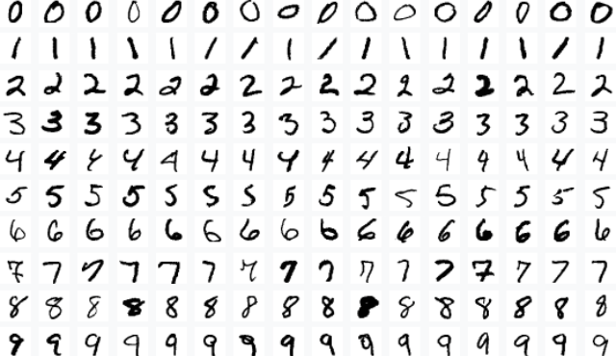
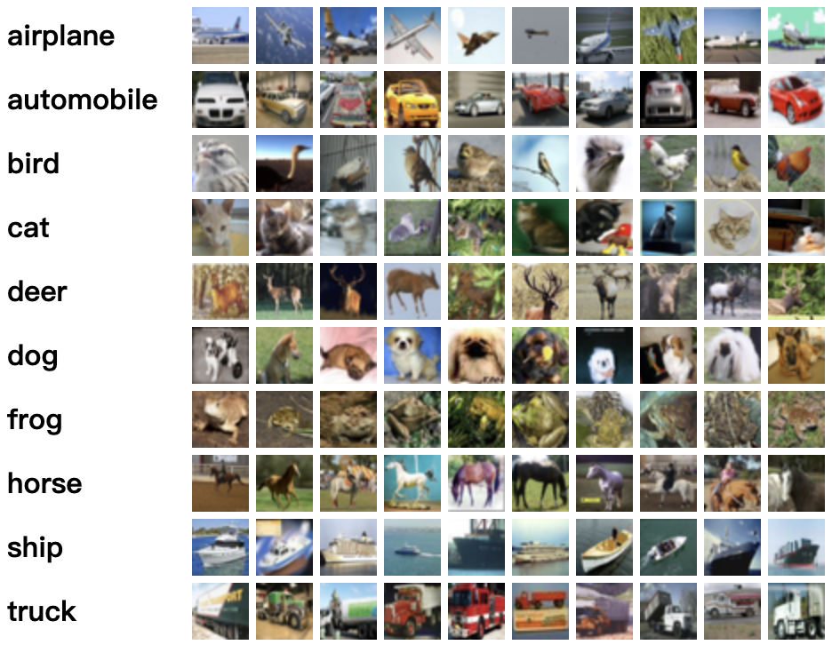
Datasets & Models
Experiment
Dataset | Description | Model | Usage | Reason
MNIST |  | ML - classification structure | Communication & computational consumption evaluation | The communication comparison only needs to compare the consumption when completing the task, so a simple model is chosen.
CIFAR-10 |  | DL - CNN Model | Performance & convergence evaluation | The essence of performance comparison is the ability to complete the task, so a more complex model is needed.

Slide 31
Data Distribution
Experiment
Method | Common Task | Advantages | Disadvantages | Description
Balanced & IID | Performance test | Dataset processing is simple | Rarely the case in real life | All clients have the same amount of data and the same type of data
Balanced & Non-IID | Challenging tasks on data heterogeneity | Different clients represent different data situations | Ignoring the imbalance of data volume among different users | All clients have the same amount of data and the different type of data
Imbalanced & Non-IID [Ours] | Real world-like scenarios | Close to real-world situations | The dataset is difficult to process | On the basis of Non-IID, the data volume of some clients is twice that of other clients
Imbalanced & Mixed-IID [Ours] | Real world-like extreme scenarios | Close to real-world situations | The dataset is difficult to process | 50% of the clients are IID, 50% are Non-IID, some of clients have twice the amount of data as other clients
IID: Independent and Identically Distributed

Slide 32
Baselines
Experiment
Method | Venue/Year | Collaboration Scheme | Personalization | Description
FedAvg^{[1]} | PMLR/2017 | Vertical-FL | ❌ | [Baseline] Random sampling, global aggregation
FedAdam^{[8][11]} | TPDS/2021 | Vertical-Adaptive Federated Optimization | Private parameter personalization | [SOTA] Random sampling, consensus global aggregation
PPT^{[7]} | Computers & Security/2023 | Horizontal-P2PFL | ❌ | [Baseline] Cumulative aggregation of temporary models
Consensus: Common information about models and data
Temporary: Intermediate model during aggregation

Slide 33
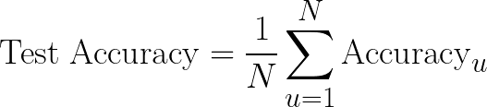
Evaluation Metrics
Experiment
Evaluation Metrics
Performance evaluations are centered on the user perspective
User-centric accuracy
Using private test sets available on user clients
Ensure that each user u has its own private test set Test_{u} with the same data distribution as the training set
For each user u, test accuracy is calculated using Test_{u} after personalized enhancements.

Slide 34
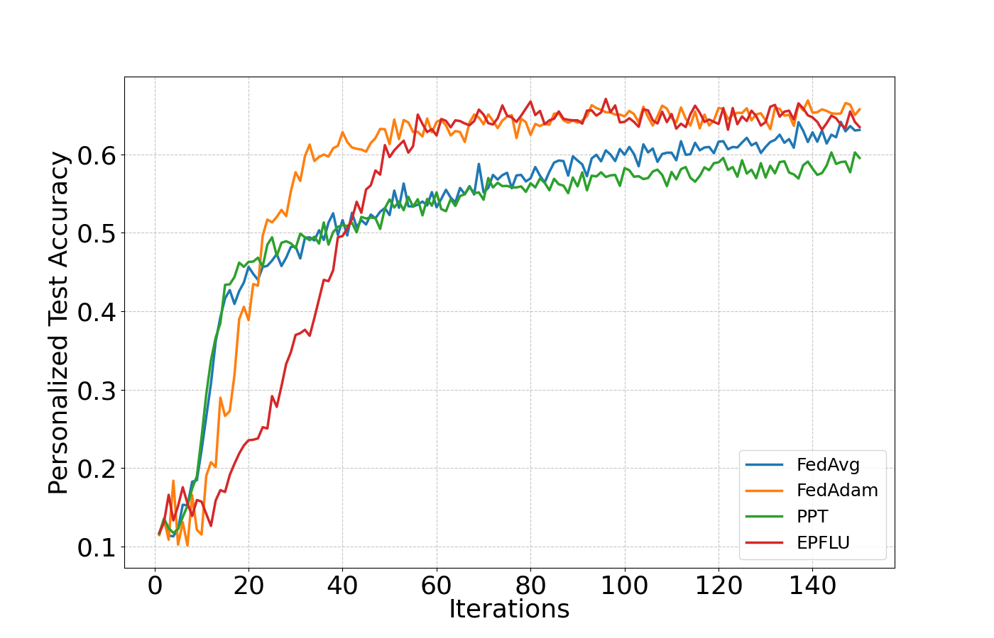
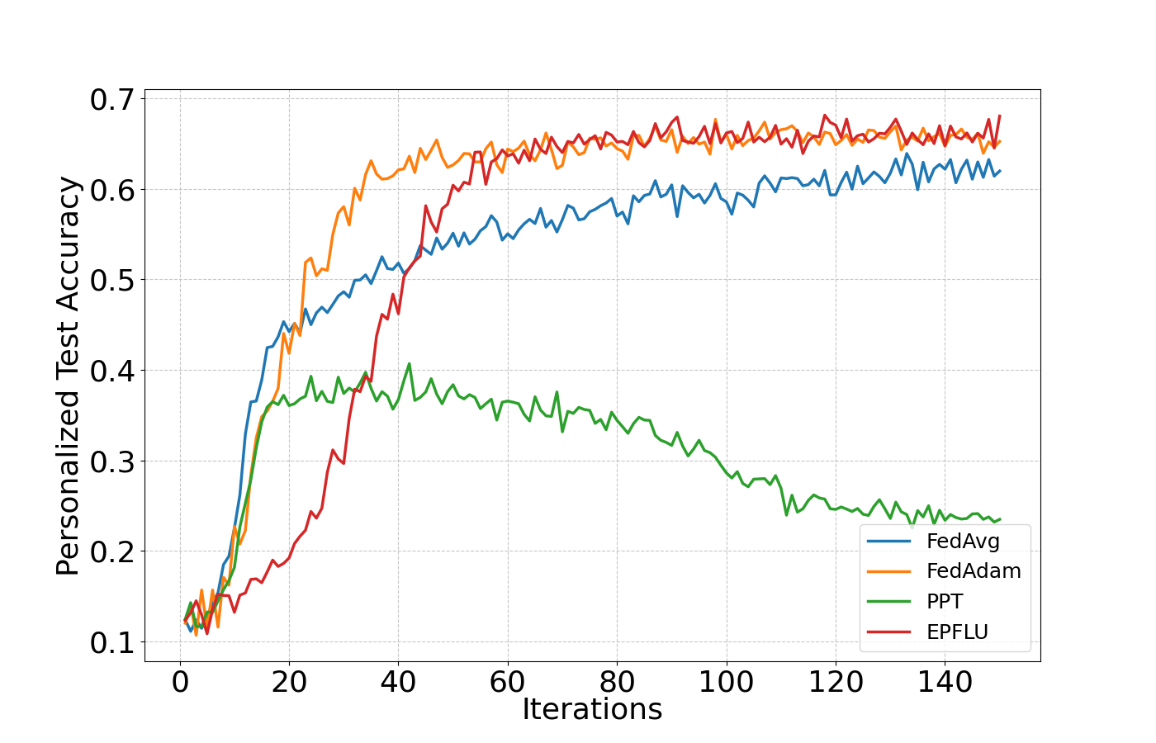
Experiment Result
Experiment
Performance and Convergence
The number of clients is 500.
Sampling rate is 0.3.
Iterations are intercepted to the stable performance position of 150 rounds.
Imbalanced-Non-IID Data scenario
Imbalanced-Mixed-IID Data scenario

Slide 35



Performance
Experiment
Convergence reaches the highest, 3% higher than FedAvg and about 5% higher than PPT
Imbalanced-Non-IID Data scenario
Imbalanced-Mixed-IID Data scenario

Slide 36
Convergence
Experiment
P2PFL (EPFLU and PPT) is slower: the decentralized nature of the P2P process, aggregation can only proceed along the aggregation path.
Imbalanced-Non-IID Data scenario
Imbalanced-Mixed-IID Data scenario

Slide 37
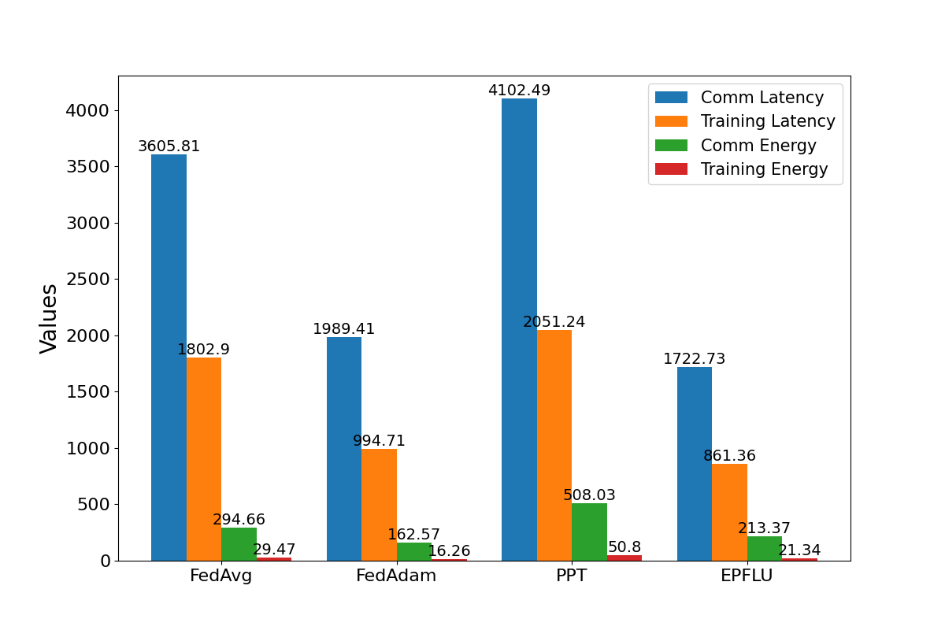
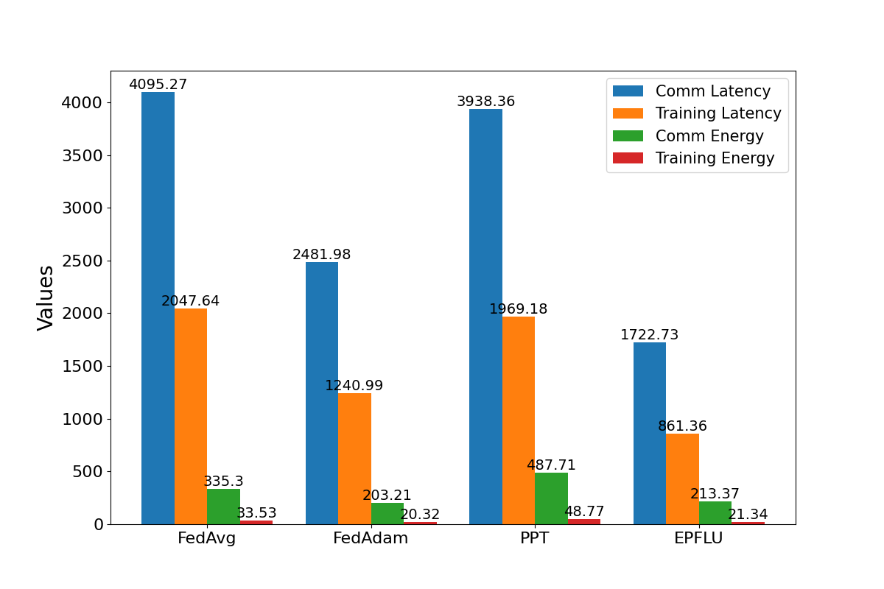
Experiment Result
Experiment
Communication & Computational Consumption
The number of clients is 500, the sampling rate is 0.3
The units of communication and computation are seconds and Joules respectively
The accuracy threshold to stop communication is 95%
Imbalanced-Non-IID Data scenario
Imbalanced-Mixed-IID Data scenario

Slide 38
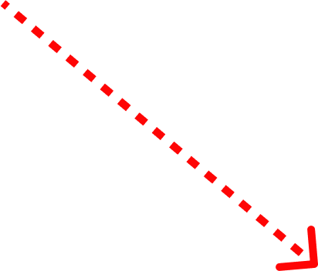
Communication & Computational Consumption
Experiment
FedAdam saves 44% and 39% communication compared to traditional FL
Imbalanced-Non-IID Data scenario
Imbalanced-Mixed-IID Data scenario
Notes:
The cost of communication rounds with the cloud is higher, but its smaller number of convergence rounds makes the communication consumption still acceptable. That means using the ML-based optimization to speed up the convergence is meaningful.

Slide 39
Communication & Computational Consumption
Experiment
FedAvg and PPT have similar communication consumption
Imbalanced-Non-IID Data scenario
Imbalanced-Mixed-IID Data scenario
Notes:
FedAvg has high communication cost, but aggregation is fast，PPT has low communication cost, but the aggregation path algorithm causes slow convergence

Slide 40
Communication & Computational Consumption
Experiment
Compared to PPT: the addition of personalization increased the improvement by 57%
Imbalanced-Non-IID Data scenario
Imbalanced-Mixed-IID Data scenario

Slide 41
Communication & Computational Consumption
Experiment
Compared to FedAdam: the addition of horizontal P2P transfer strategy provides 21% improvement
Imbalanced-Non-IID Data scenario
Imbalanced-Mixed-IID Data scenario

Slide 42
Experiment Result
Experiment
The effect of our method
Consensus aggregation: alleviating the data heterogeneity problem
Personalization process: rapid convergence
Horizontal transfer: low communication consumption
Imbalanced-Non-IID Data scenario
Imbalanced-Mixed-IID Data scenario

Slide 43
Conclusion & Future Work
Notes:
So here is the conclusion of our work and plan for the future.

Slide 44
Conclusion
Summary

Slide 45
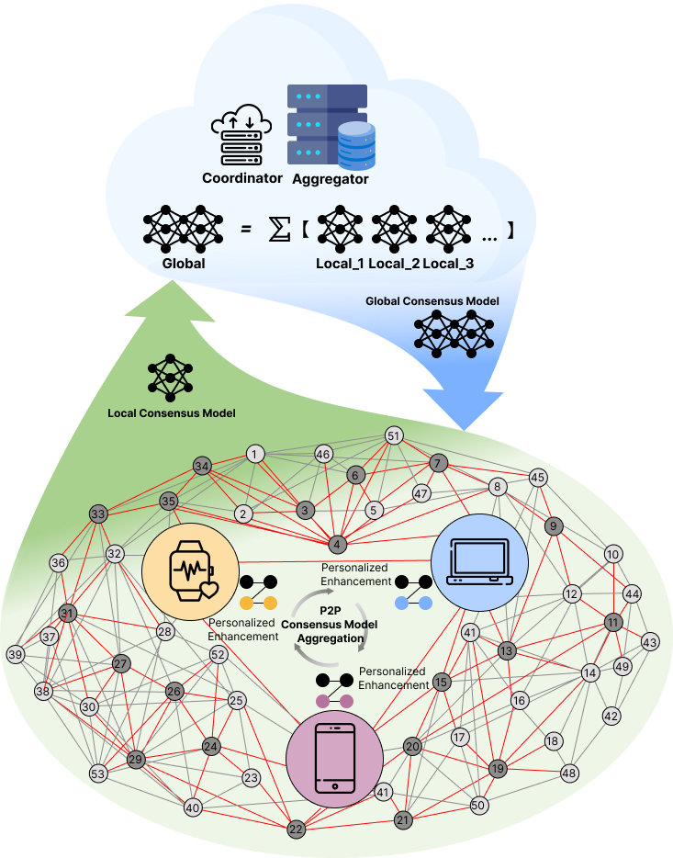
Conclusion
Summary
EPFLU: An Efficient P2PFL Framework from the User Perspective

Slide 46
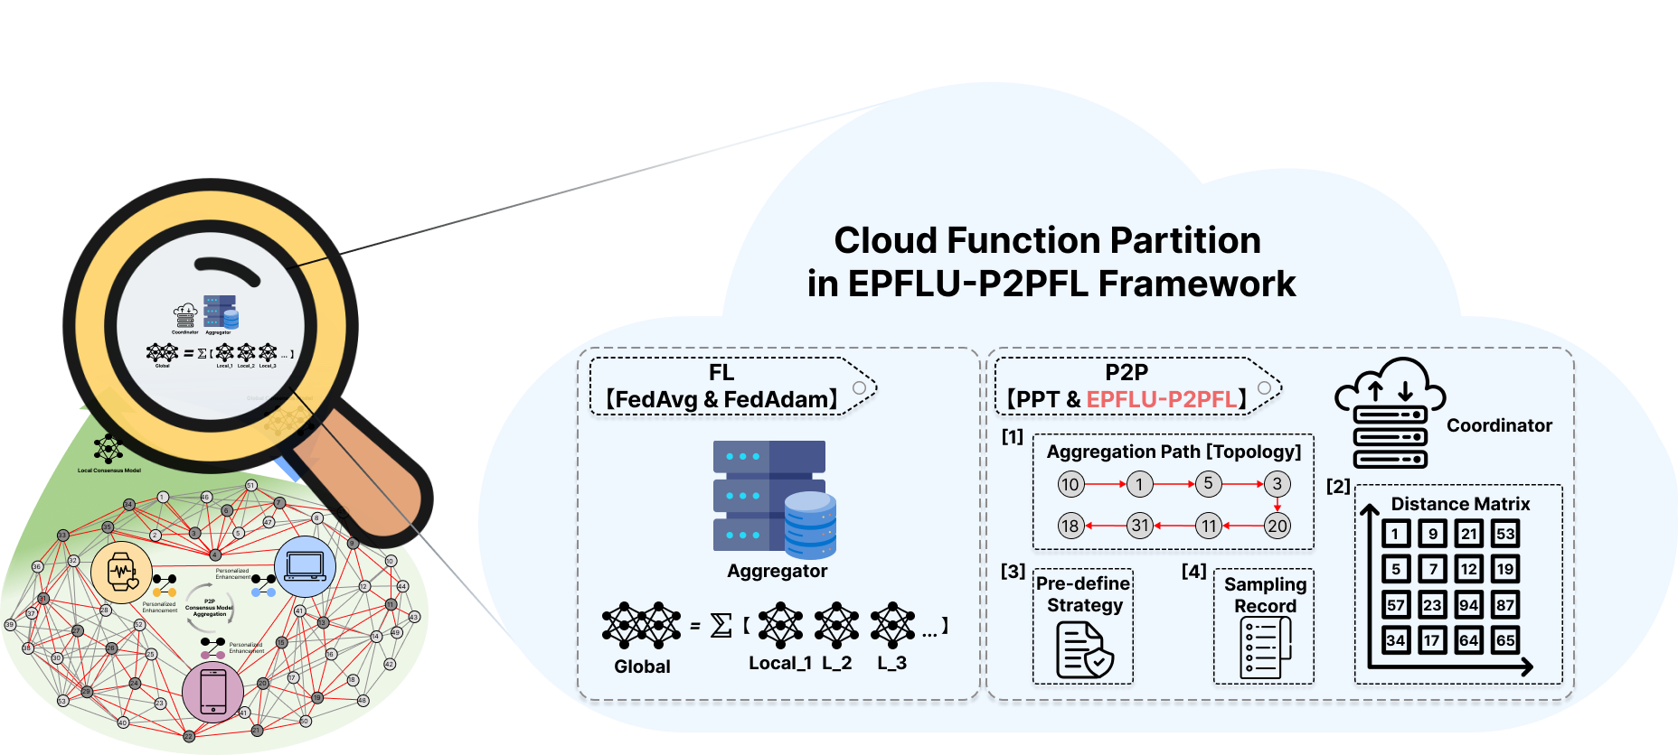
Conclusion
Summary
EPFLU: An Efficient P2PFL Framework from the User Perspective
Horizontal strategy: A coordinator is built in the cloud, which makes the process from vertical to horizontal to reduce communication consumption.

Slide 47

Conclusion
Summary
EPFLU: An Efficient P2PFL Framework from the User Perspective
Horizontal strategy: A coordinator is built in the cloud, which makes the process from vertical to horizontal to reduce communication consumption.
Consensus and personalization strategy: Reduce computational consumption through consensus model aggregation and alleviate weakening effects through personalized parameters.

Slide 48
Conclusion
Summary
EPFLU: An Efficient P2PFL Framework from the User Perspective
Horizontal strategy: A coordinator is built in the cloud, which makes the process from vertical to horizontal to reduce communication consumption.
Consensus and personalization strategy: Reduce computational consumption through consensus model aggregation and alleviate weakening effects through personalized parameters.
A comprehensive experiment design: a data distribution method that conforms to the real-world, considering the simulation of the actual communication cost, proves the stability and superior performance of EPFLU.

Slide 49
Future Work
Summary
Decision-making strategy between training and communication
Complete the trade-off between final training results and communication cost
Accelerate the model training process to reduce convergence rounds
Choose a low-communication method for model and parameter transmission to reduce the communication cost of each round.
Collaboration enhancing between edges
Little is known about the characteristics of real-life local data stored on edge devices
A set of distinguishable or evaluable criteria, such as model type, task type, data content, and convergence trends
Select representative clients for direct point-to-point communication and supplementation ^{[5]}

Slide 50
Thank you
EPFLU: Efficient Peer-to-peer Federated Learning for Personalized User Models in Edge-Cloud Environments
Xiangchi Song*, Zhaoyan Wang, Kyeongdeok Baek, and In-Young Ko
{xcsong, zhaoyan123, kyeongdeok.baek, iko}@kaist.ac.kr
Web Engineering and Service Computing Lab,
Korea Advanced Institute of Science and Technology (KAIST)
2024. 06. 17

Slide 51
APPENDIX
Adaptive and Optimal Aggregation Path Generation Algorithm
Personalization Algorithm
Special Case: the broken of PPT
Evaluation Framework

Slide 52
Cloud Function Partition
Approach
An adaptive and optimal aggregation path
Generating distance matrix based on client relationships.
Selecting the central client as the starting point and randomly select a specified number of clients for aggregation.
Using mixed DFS & BFS approaches to form connection topology.
Optimizing topology to improve client efficiency.

Slide 53
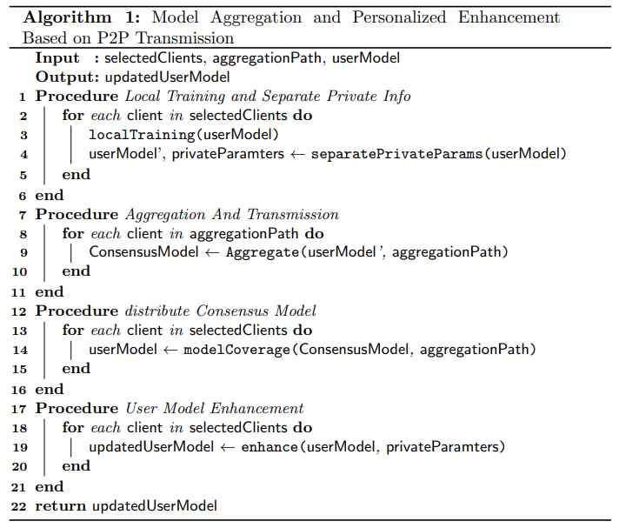
Model Personalization Enhancement
Approach
Model Personalization Enhancement
Local Training and Separate Private Info
Only for user models
Aggregation and Transmission
aggregationPath Guiding
Distribute Consensus Model
aggregationPath Guiding
User Model Enhancement
Only for users on aggregationPath
Fig.7 : Model Personalization Enhancement Algorithm

Slide 54
Performance and Convergence
Experiment
The broken of PPT: Caused by data heterogeneity.
P2P-based framework uses random sampling and sequential horizontal aggregation, so it is impossible to predict the data amount and distribution of the next client.
Lacking personalization support, sequential aggregation can cause model confusion or stagnation, or even have negative impact, if clients on the aggregation path have different data amount and distributions.
Imbalanced-Mixed-IID Data scenario

Slide 55
Evaluation Framework
Notes:
Now I will discuss the evaluation of DESA.

Slide 56
Evaluation Framework
Evaluation
Comprehensive and Detailed Simulation Framework
The evaluation framework needs to be re-designed due to changes in designed communication structures：
Enhance the realism of EPFLU
A more accurate assessment of the communication overhead of our approach
The communication relationship between the cloud and the edge and between edge devices cannot be ignored:
Hata model suitable for urban areas ^{[10]}
Free Space Path Loss (FSPL) model
[10] Hata, M.: Empirical formula for propagation loss in land mobile radio services. IEEE transactions on Vehicular Technology 29(3), 317–325 (1980)

Slide 57
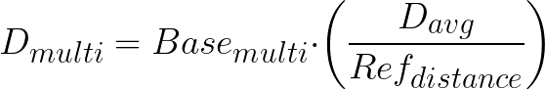
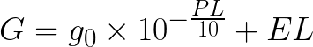
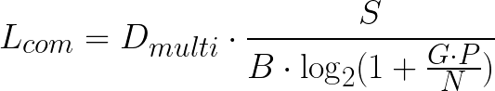
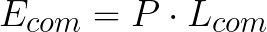
Evaluation Framework
Evaluation
Comprehensive and Detailed Simulation Framework
A simplified urban environment path loss model：
Reference path loss at distance d：
General path loss：
Dynamic multiplier：
Adjusted channel gain：
Communication latency：
Communication energy consumption：

